Slide 1


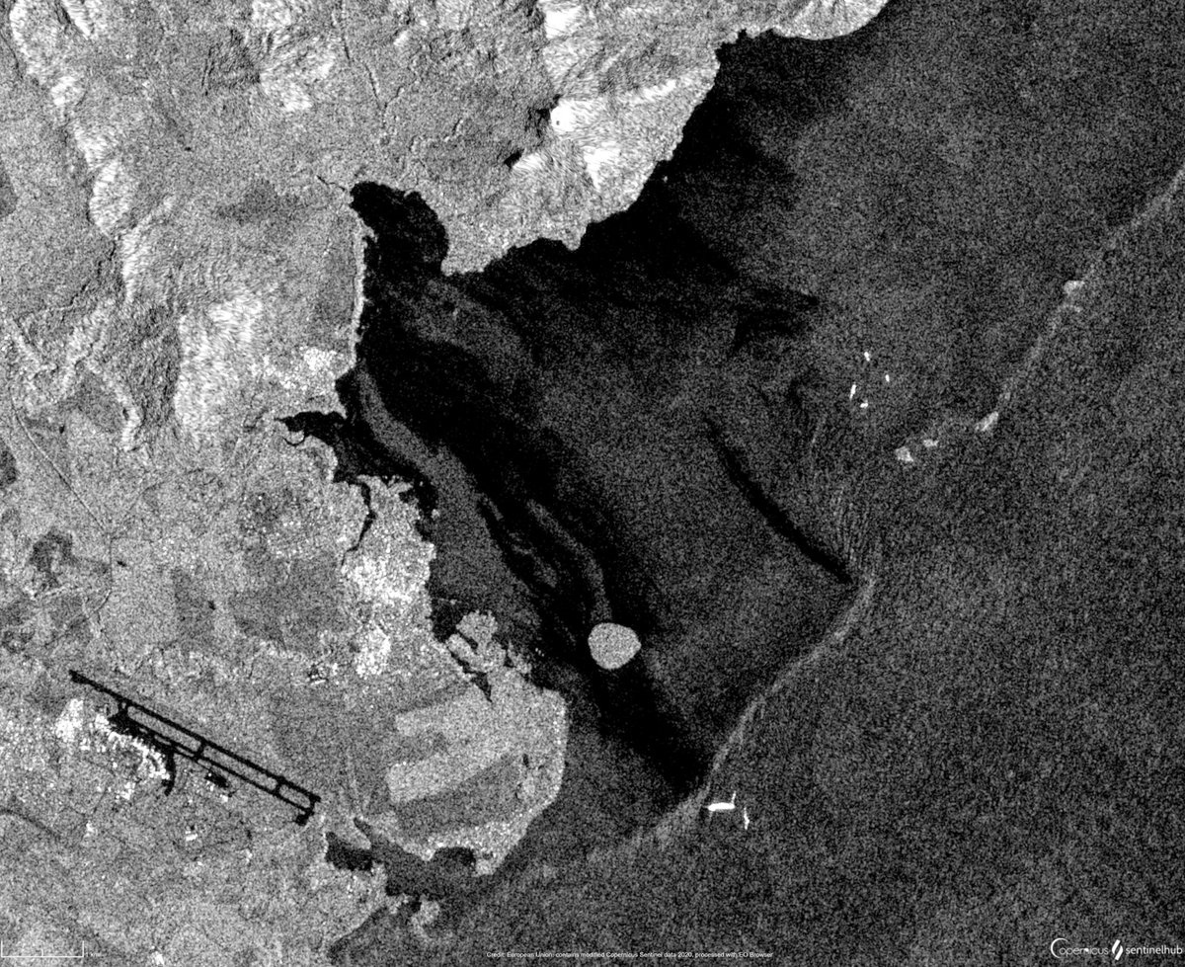

Neural Networks for
SAR Oil Spill Detection
Applied Data Science Project
Bianca Bartoli - s322799
Carlo Marra - s334220
Alessandro Valenti - s328131

Slide 2
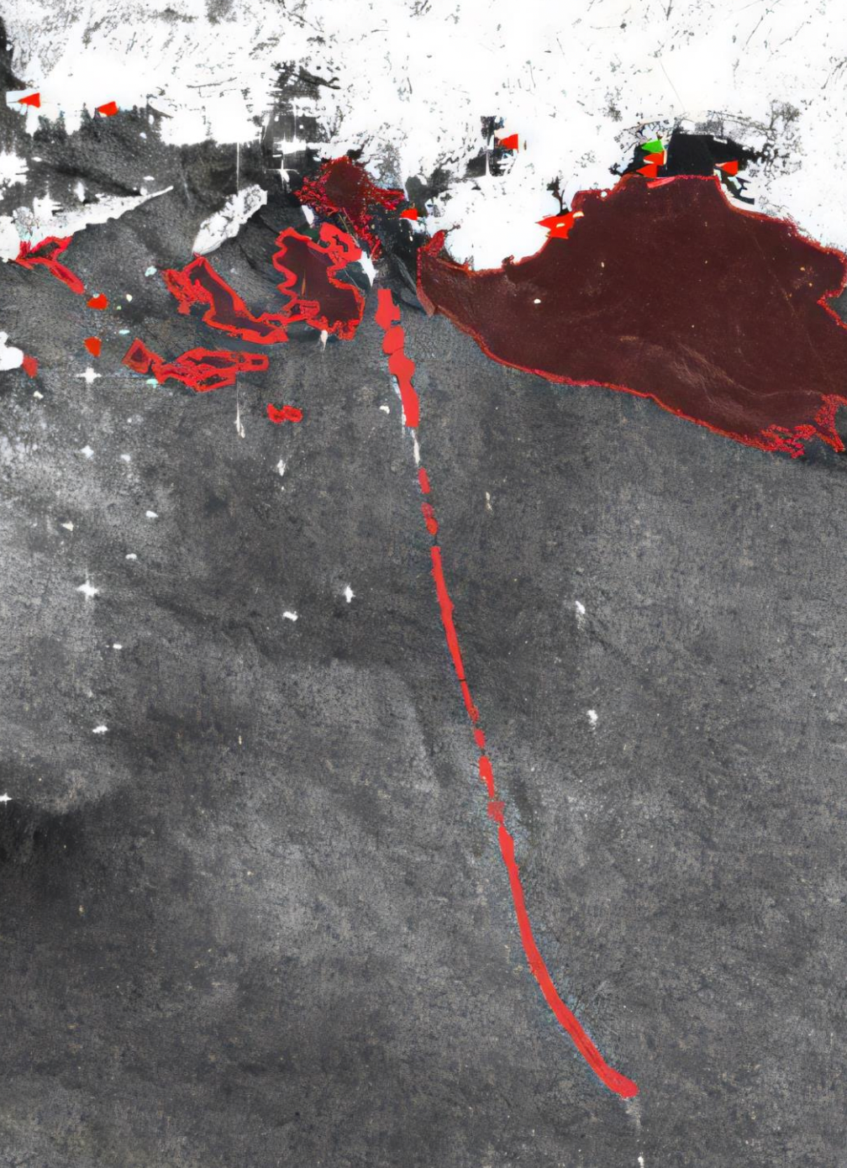





VALUE PROPOSITION
Main goal of the project: developing models to enable continuous monitoring and precise detection of oil spills
Oil spills pose a significant threat to marine ecosystems
Environmental Impact
Faster response times can significantly reduce the environmental damage caused by oil spills
Response Efficiency
Early detection and response help contain the spill, reducing the resources needed to manage its spread
Scalability
The developed system can be applied to any marine environment with SAR imaging availability, offering potential for global deployment

Slide 3
RESEARCH
QUESTIONS

Slide 4

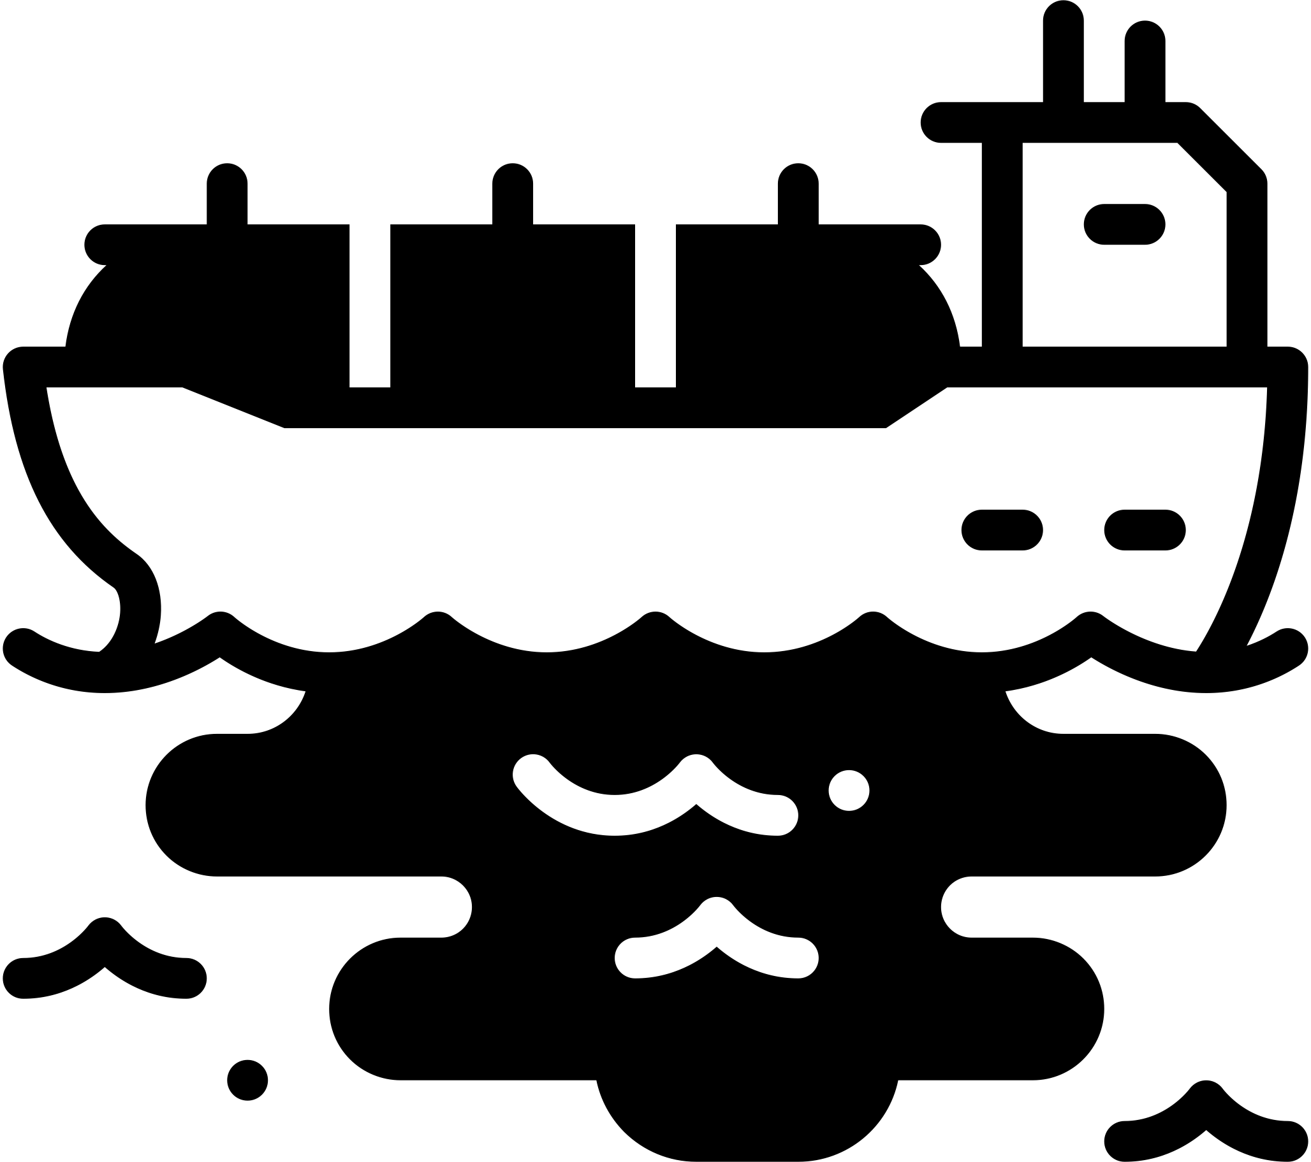



OBJECTIVE
Current monitoring systems, such as CleanSeaNet deployed by the European Union, lack AI-based solutions for detecting and pinpointing oil spills.
Our objective is to investigate the potential usage of Segmentation models to improve both the effectiveness and the responsiveness of the monitoring systems.
Maria
Environmental Supervisor
ACCURATE AND FAST MODEL

Slide 5



ACCURACY
Which ML model provides the best performance for oil spill segmentation in SAR images (IoU)?
How does IoU performance vary across different classes?
Are certain models better at distinguishing ships, oil spills, or look-alikes?
TRAINING TECHNIQUES
What kind of techniques on the dataset influence the detection of oil spills?
Which techniques lead to more effective oil spill detection?
Which strategy help the model achieve faster convergence?
COMPUTATIONAL EFFICIENCY
Balancing accuracy and efficiency:
What are the trade-offs?
Can lightweight models achieve competitive accuracy?

Slide 6
DATASET
EXPLORATION

Slide 7
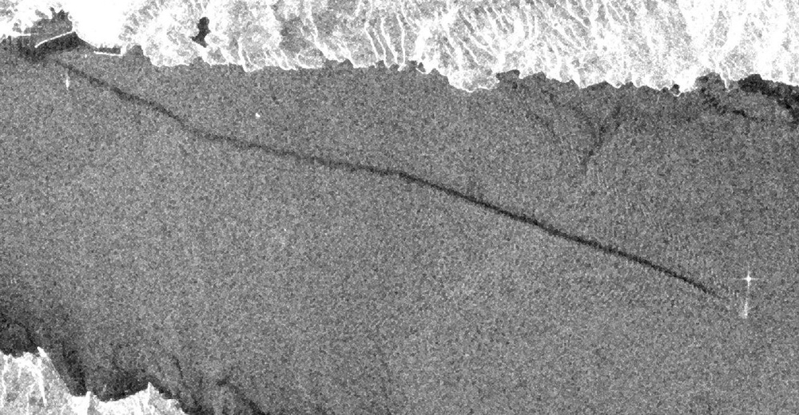
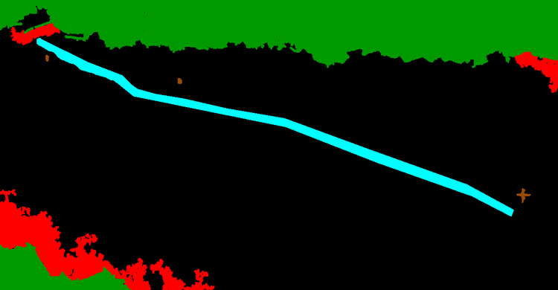

Images are taken by the ESA Satellite Sentinel-1
All images have dimensions 1250 x 650
Patches of dimension 320 x 320 are fed to models
4
1
0
3
2
Original SAR image
Ground truth mask
Explicit labels mask
3 greyscale identical channels
3 rgb channels
1 label channel
Sea Surface
0
Sea Surface
Oil Spill
1
Oil Spill
Look-alike
2
Look-alike
Ship
3
Ship
Land
4
Land

Slide 8
DATA PREPROCESSING

Slide 9
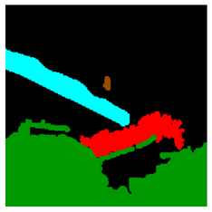
BASELINE AUGMENTATIONS
Starting from the original image, the applied transformations are:
Original Image
Random resize
with a scale from 0.5x to 1.5x
320x320 Crop
Horizontal Flip
with a probability of 50%
Augmented Image
Augmented Mask
Vertical Flip
with a probability of 50%

Slide 10
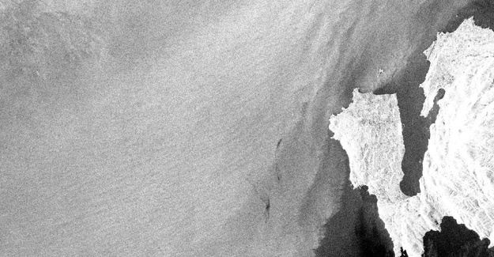
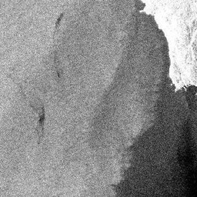
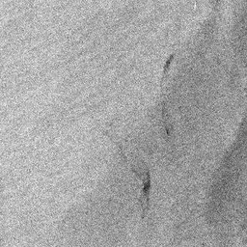

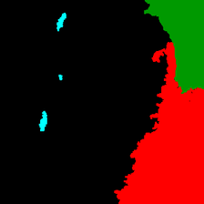
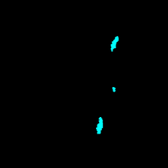
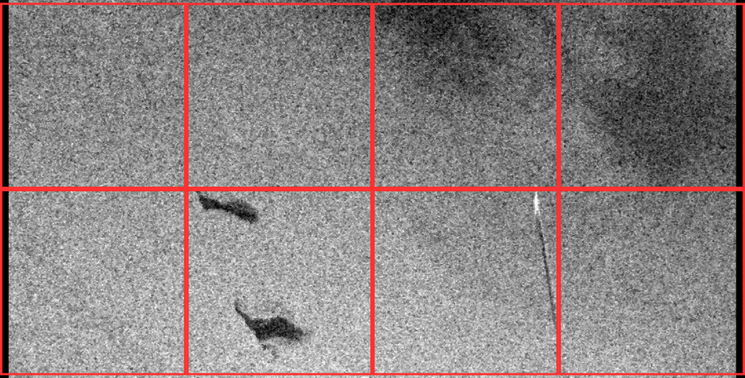
PROPOSED TRAINING TECHNIQUES
Original Image
Focused Crop Examples
Focused Crop on Oil Spill
Sliding window Crop

Slide 11
IMPLEMENTATION
& TRAINING

Slide 12
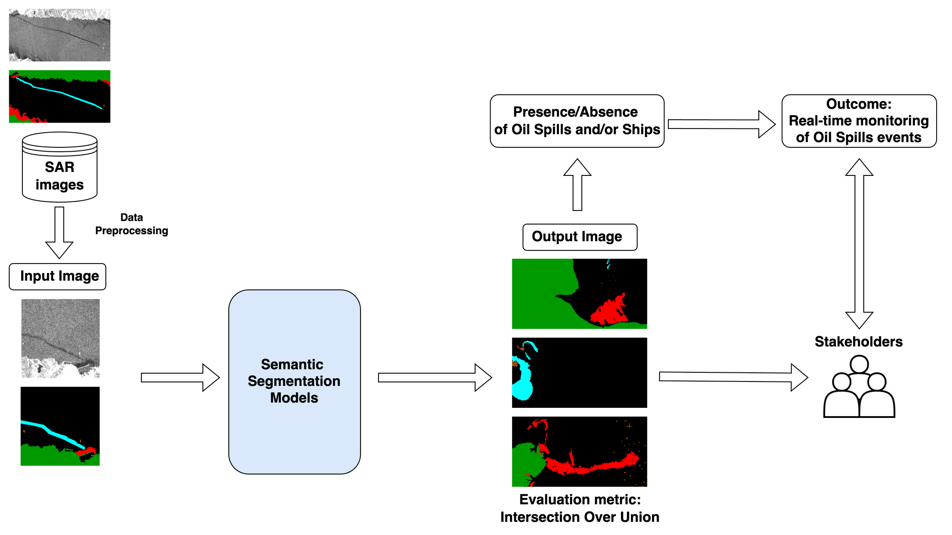
GENERAL OVERVIEW
UNet
LinkNet
PSPNet
DeepLabv3
CBD-Net

Slide 13

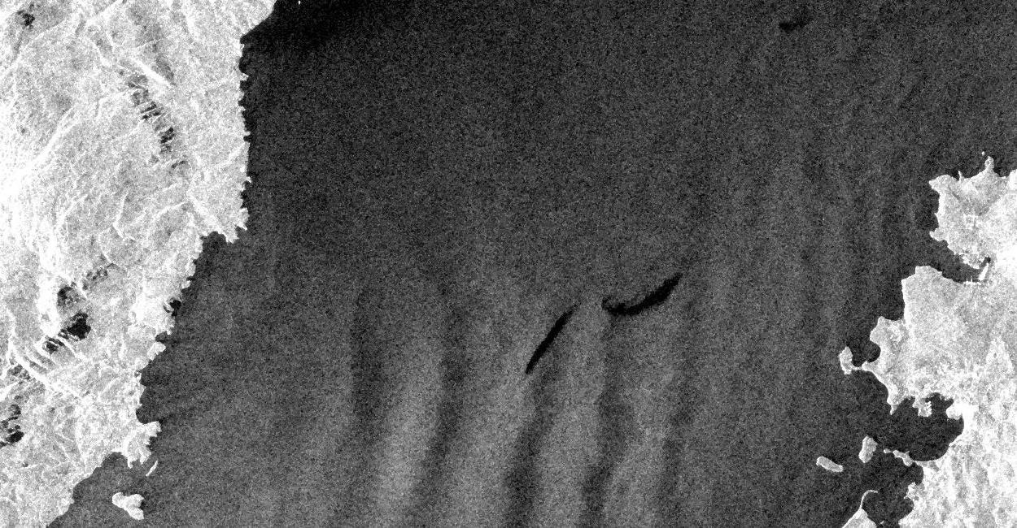
TRAINING METHOD
Model Details:
Training framework:
Model | Learning rate | Parameters | Size (MB)
U-Net | 0.0001 | 51.5M | 541.67
LinkNet | 0.00005 | 50.2M | 539.74
PSPNet | 0.0001 | 43.3M | 168.76
DeepLabv3 | 0.0001 | 4.7M | 49.88
CBD-Net | 0.0001 | 38.8M | 409.99
We chose PyTorch Lightning for its modular workflow, which simplifies data handling, training, and testing, ensuring efficient and organized development.

Slide 14
DATASET HANDLING
Training
Test
1002 images
110 images
85%
15%
Training
Validation
Test
Class | Pixels | Loss Weight
Sea Surface | 797.7M | 1
Oil Spill | 9.1M | 2
Look-alike | 50.4M | 1
Ships | 0.3M | 4
Land | 45.7M | 1
Dataset imbalance
We deal with an imbalanced dataset. To account for it, we applied this weighting scheme to the loss function of the trained models:

Slide 15
EXPERIMENT
& RESULTS

Slide 16
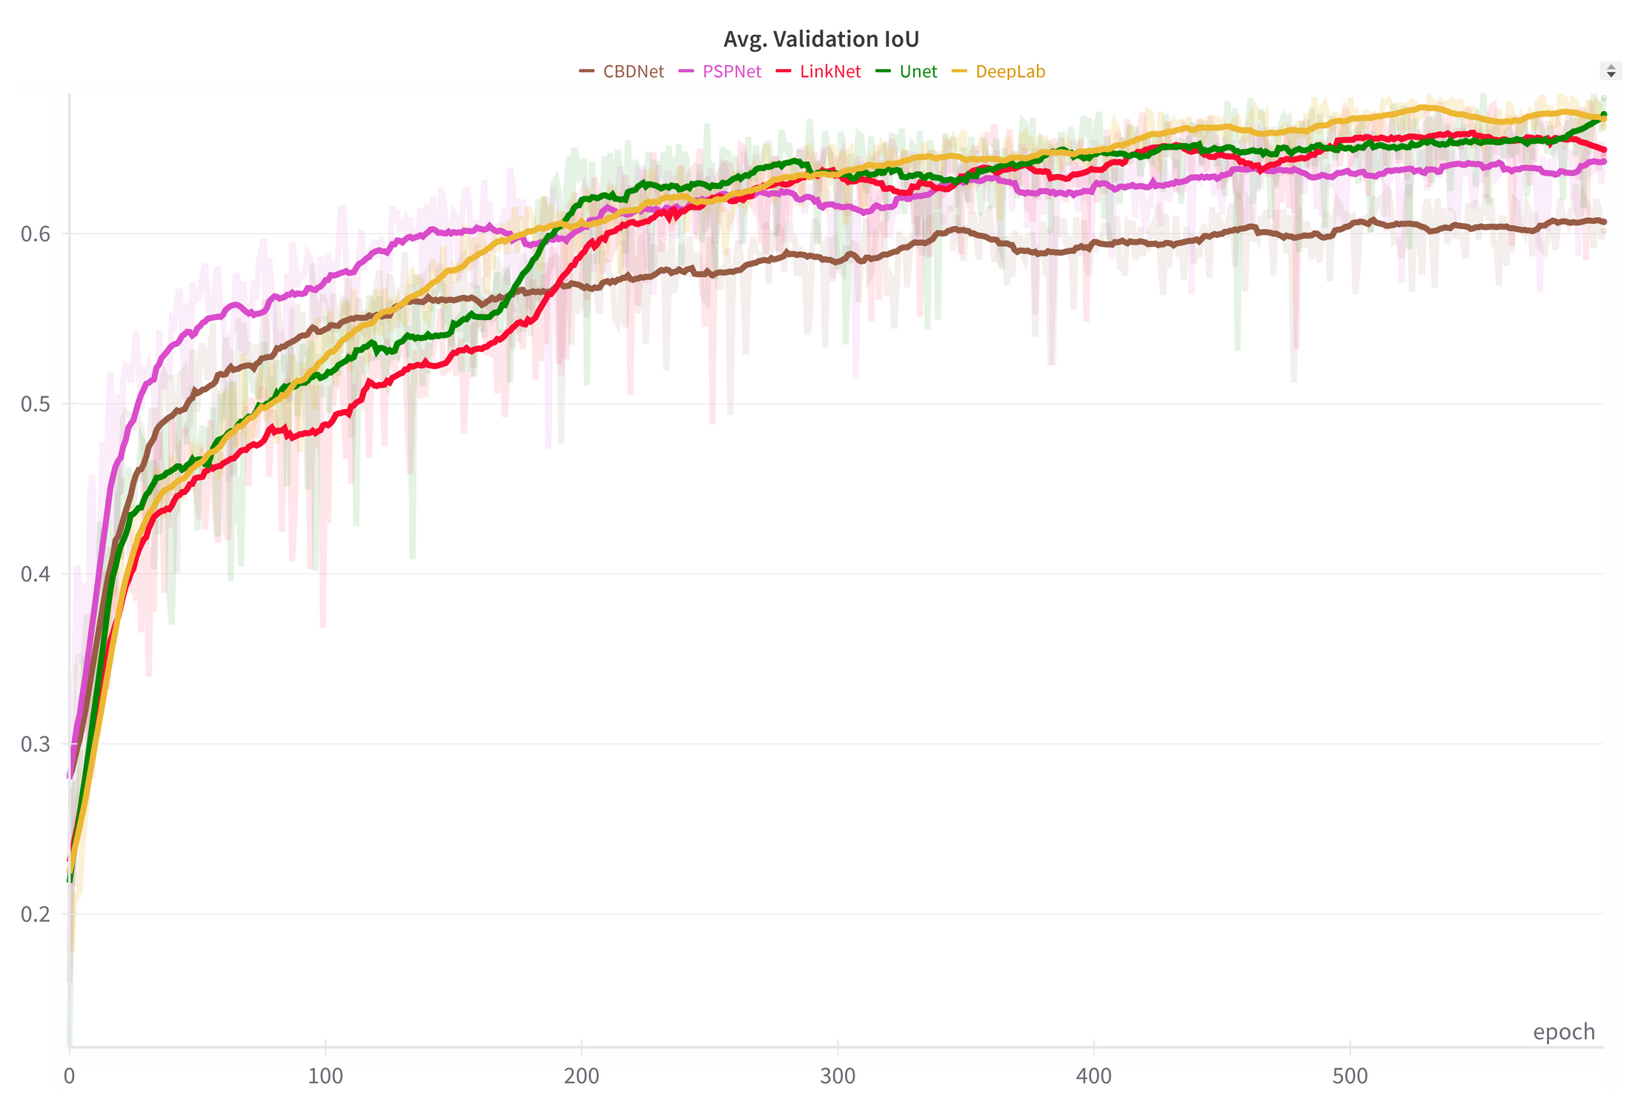
TRAINING COMPARISON
UNet
LinkNet
PSPNet
DeepLabv3
CBD-Net
The graph shows the running average IoU of the models over 20 training epochs.

Slide 17
TEST RESULTS
 | U-Net | LinkNet | PSPNet | DeepLabV3+ | CBD-Net
Sea Surface | 0.9555 | 0.9527 | 0.9327 | 0.9609 | 0.9437
Oil Spill | 0.5554 | 0.5485 | 0.4444 | 0.5262 | 0.5261
Look-alike | 0.4918 | 0.4247 | 0.3652 | 0.4874 | 0.4461
Ships | 0.2672 | 0.3405 | 0.2141 | 0.3131 | 0.2588
Land | 0.9500 | 0.9326 | 0.9485 | 0.9392 | 0.86.96
Mean IoU | 0.6440 | 0.6398 | 0.5810 | 0.6454 | 0.6088

Slide 18
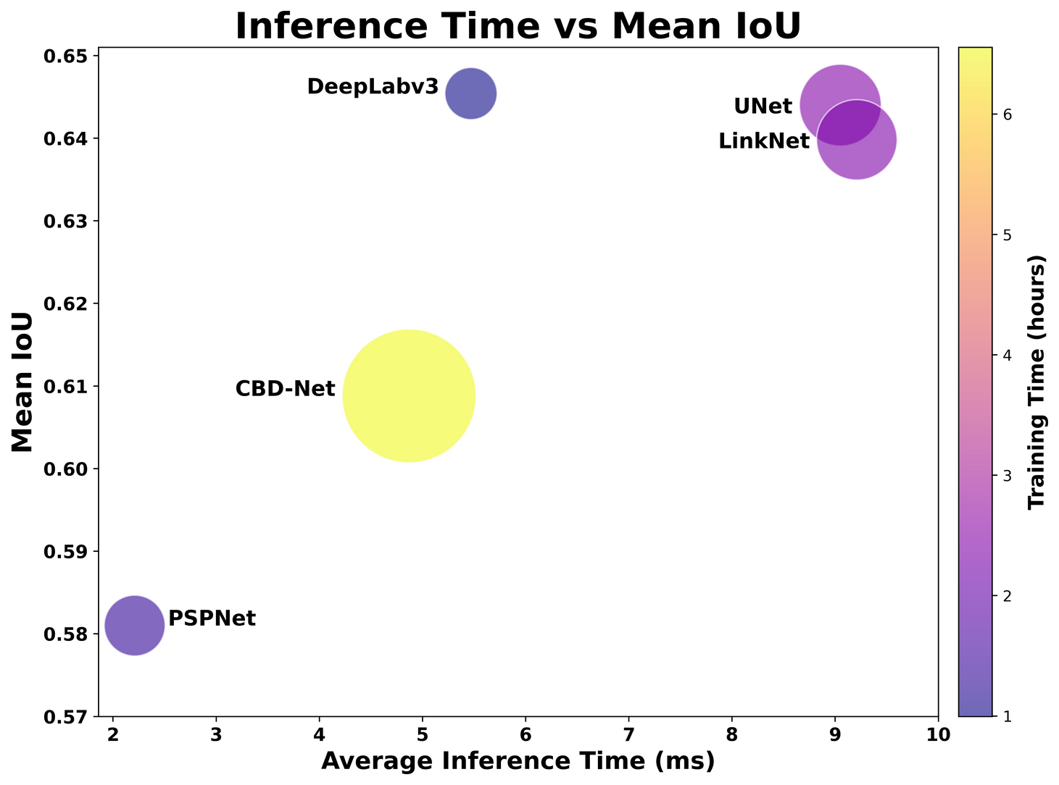
MODEL EVALUATION
Model | Mean IoU | Avg Inference Time (ms) | Training Time
U-Net | 0.6440 | 9.05 | 2h 26m 40s
LinkNet | 0.6398 | 9.21 | 2h 22m 6s
PSPNet | 0.5810 | 2.21 | 1h 21m 19s
DeepLabv3 | 0.6454 | 5.47 | 59m 47s
CBD-Net | 0.6088 | 4.87 | 6h 44m 16s

Slide 19
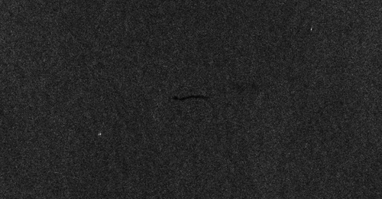
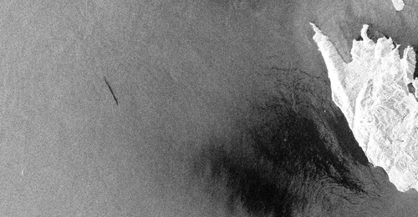
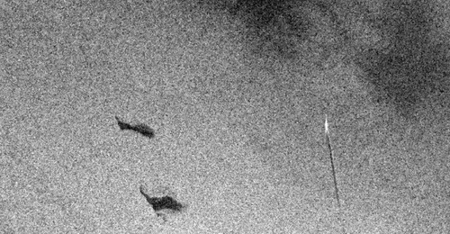

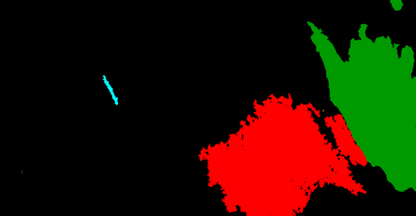
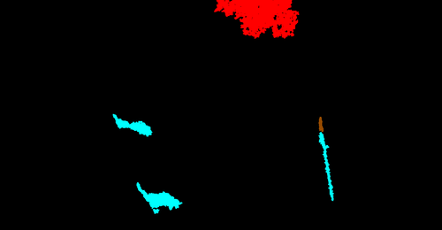
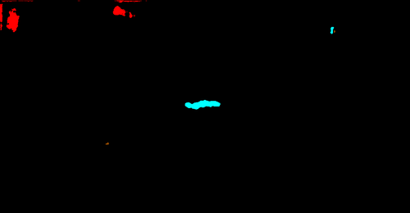
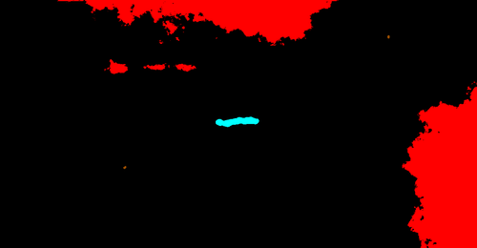
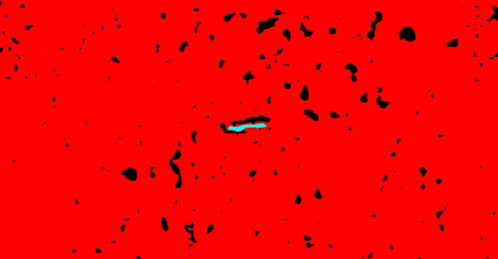
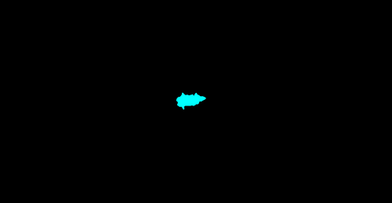

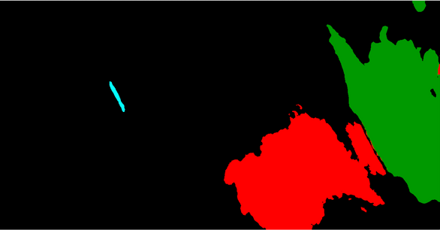
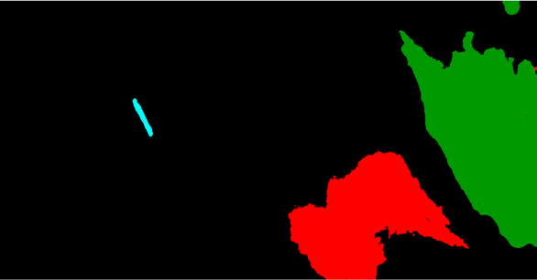

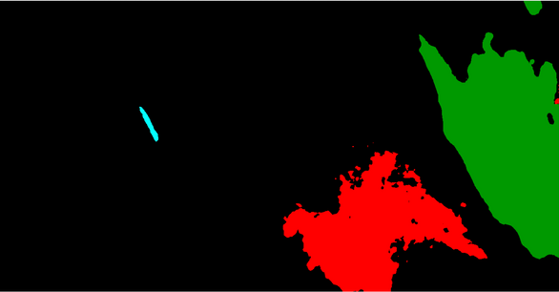
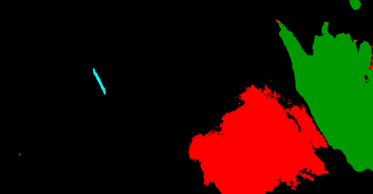
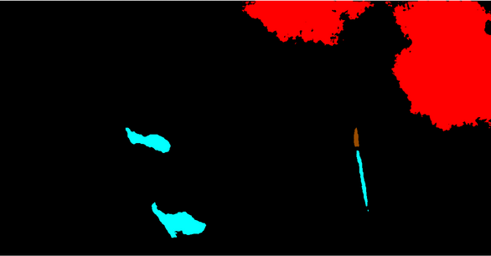
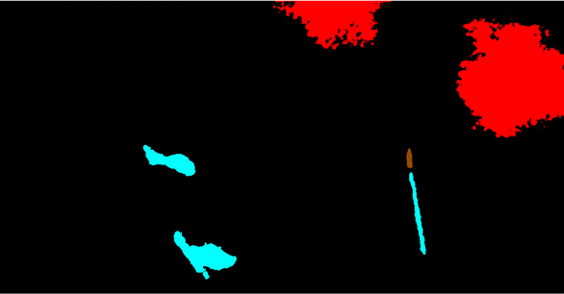
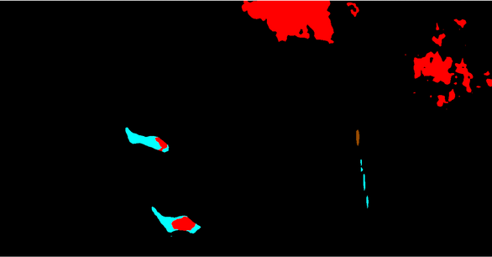
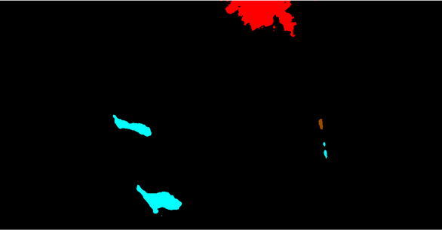
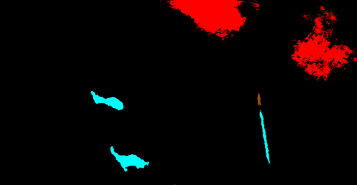
SEGMENTATION
COMPARISON
SAR Image
Ground Truth
1
2
3
U-Net
LinkNet
PSPNet
DeepLabV3+
CBD-Net
1
2
3

Slide 20
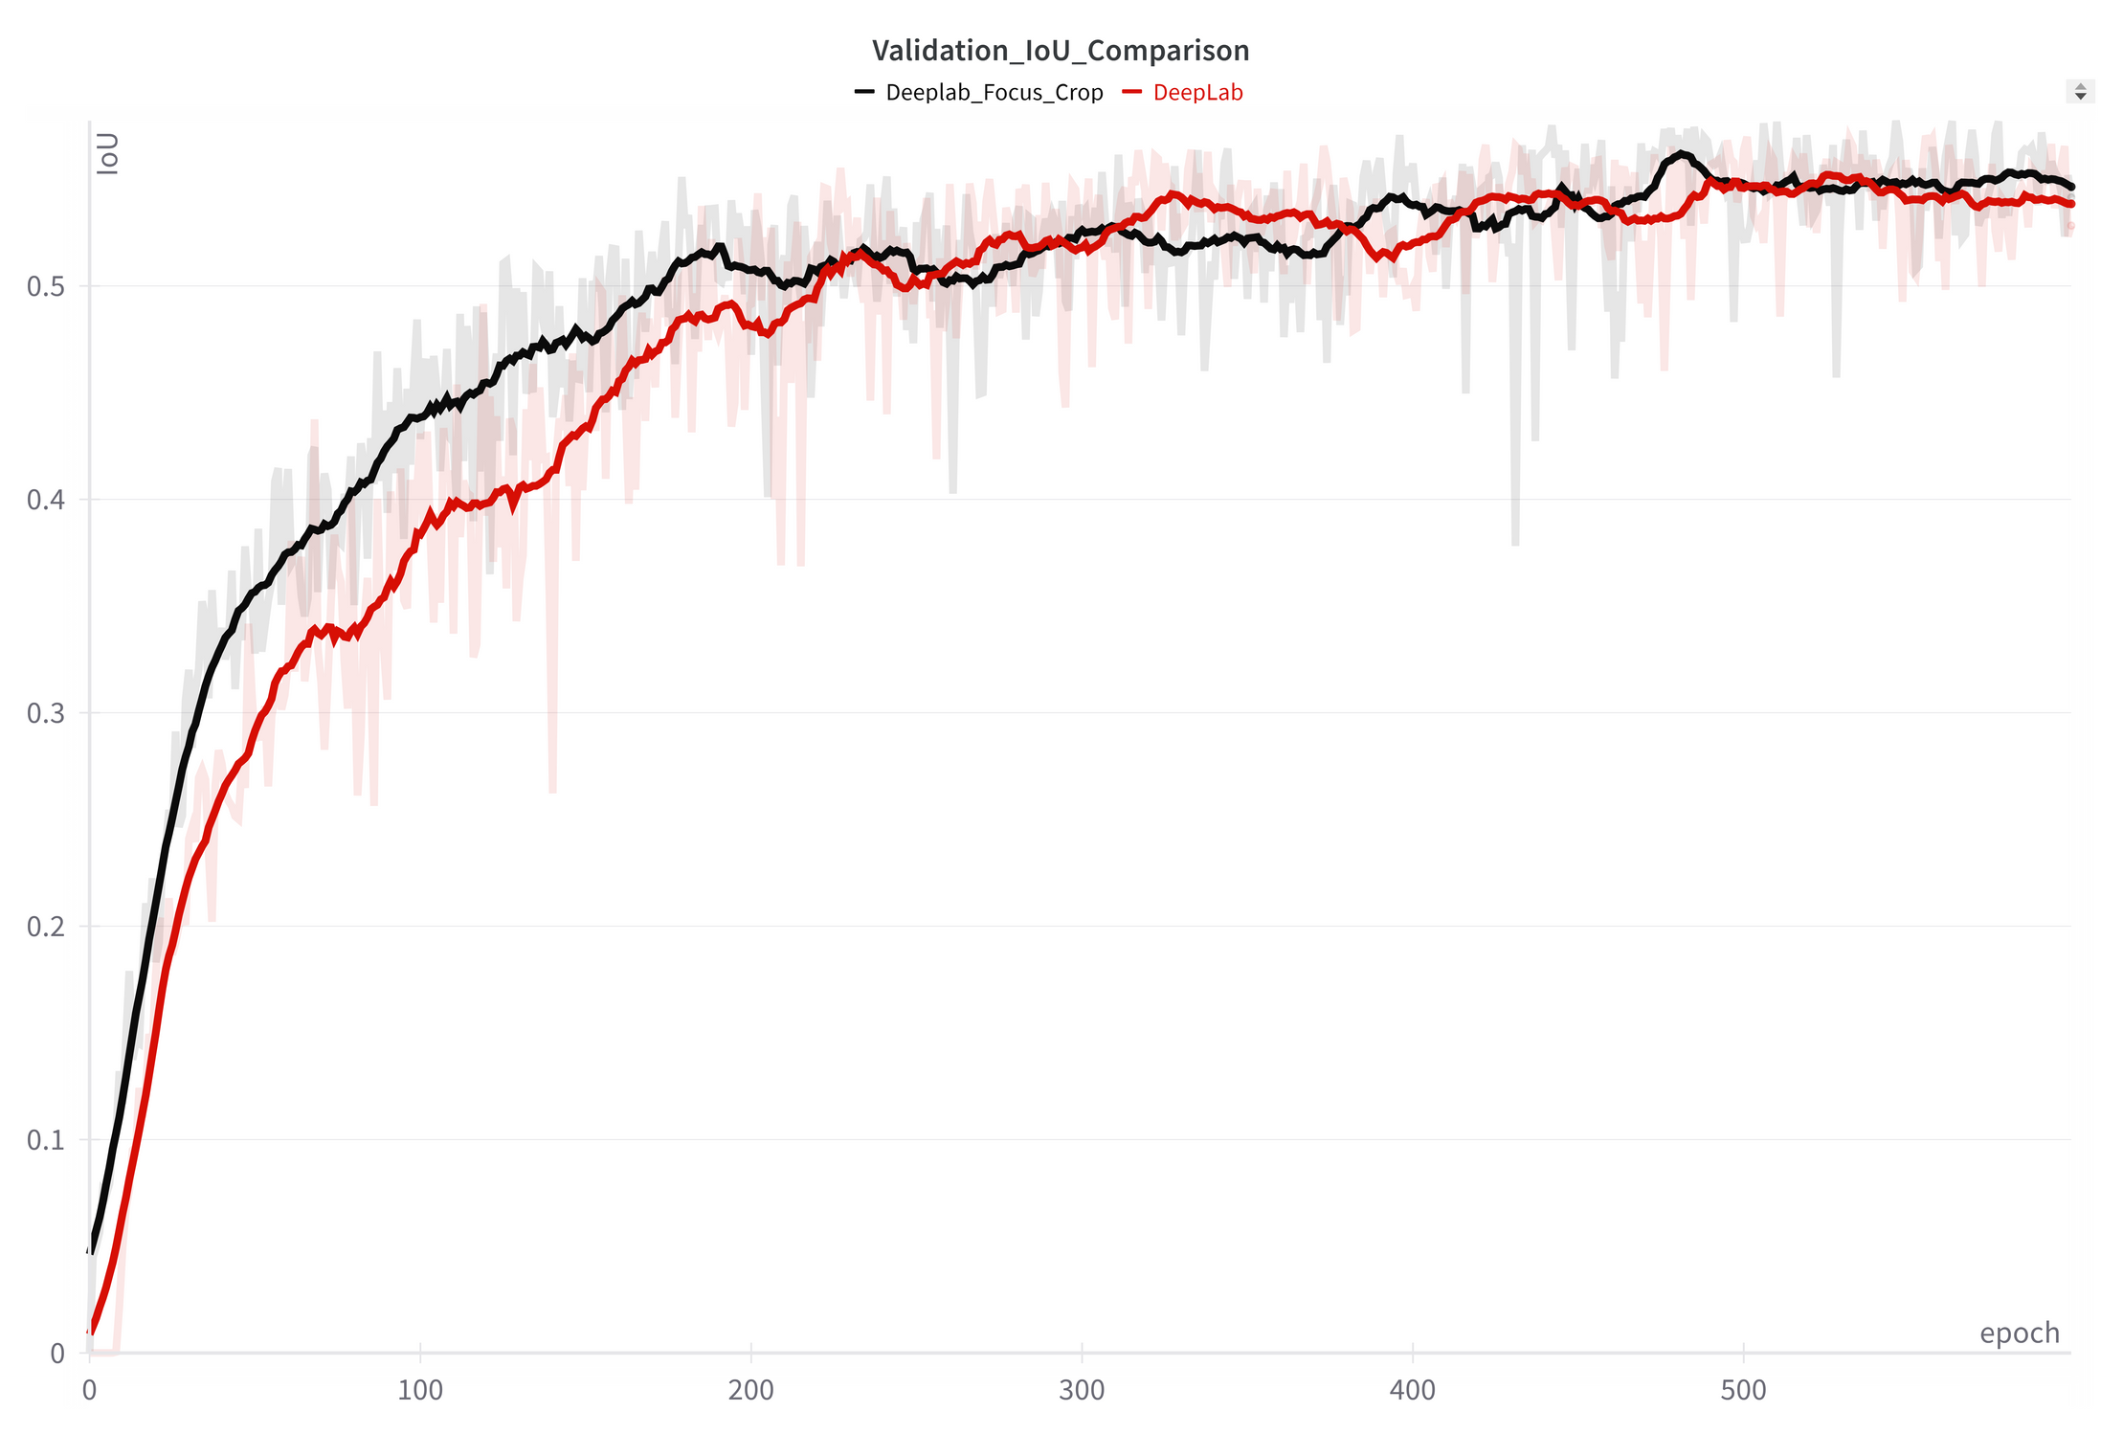
EXTENSION RESULTS
 | DeepLabV3+ | Focused Crop | Sliding Window
Sea Surface | 0.9609 | 0.9555 | 0.9400
Oil Spill | 0.5262 | 0.4971 | 0.4539
Look-alike | 0.4874 | 0.4748 | 0.3277
Ships | 0.3131 | 0.3288 | 0.2551
Land | 0.9392 | 0.9217 | 0.8863
Mean IoU | 0.6454 | 0.6356 | 0.5726
DeepLabv3
Focused Crop

Slide 21
CONCLUSIONS
Key remarks from our study:
We achieved promising results in identifying oil spill regions.
DeepLabv3+ proved to be the most suitable model for the task among those evaluated, guaranteeeing the best trade-offs between accuracy and efficiency
Challenges in segmenting underrepresented classes, particularly ships.
Targeted cropping emphasized relevant features, leading to faster training convergence, without significantly compromising performance.
Future Directions:
Noise Reduction: Develop advanced despeckling techniques for addressing the inherent noise present in SAR imagery.
Class Imbalance: Develop synthetic data to address underrepresented categories.
Hybrid Approaches: Combine CNNs with transformers for more robust solutions.
Open Source development: We advocate for the creation of an open source, foundational dataset of SAR imagery to address current challenges and fostering research in the field of oil spill detection.

Slide 22
Thank you for your attention
Any questions?
Bianca Bartoli - s322799
Carlo Marra - s334220
Alessandro Valenti - s328131
For further information, visit our GitHub repository!

